Slide 1

50.051 Programming Language Concepts W9-S2 Lexical Analysis and Tokenization (Part 2)
Matthieu De Mari

Slide 2
Where are we right now?
We have functions that:
Scan a source.c file for code and puts it into a string,
Splits the string using whitespaces and \n symbols to produce lexemes,
Checks those lexemes to recognize, using RegEx, if each lexeme matches a vast collection of keywords, operators, punctuation signs, identifiers or literals, or is an unknown type of lexeme,
In case of a match, create a token which assembles the TOKEN_TYPE that has been recognized and the lexeme,
And, if no type is recognized, assign a default TOKEN_UNKNOWN type.

Slide 3
Where are we right now?
On this lecture,
Relaxing the hypothesis that all elements/lexemes in our source code are nicely separated with whitespaces or \n symbols.
Conflict resolution in the case of ambiguous tokens that could be classified as more than one type.
Error handling in the case of incorrect/unknown lexemes.
Recognizing and dropping comments.
(If time allows, pre-processing)
Closing on the topic of Tokenization.

Slide 4
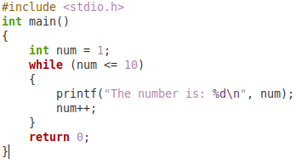
Important hypothesis we made
Hypothesis: The source code will have all the substrings that will become our future lexemes, clearly separated using whitespaces and \n symbols.
This will allow for a very simple string splitting to produce lexemes.
In practice, almost never true, this assumpution will have to go.
→ Left-to-right scan, character by character, to produce lexemes.

Slide 5
An intuition for an updated splitting procedure
If this hypothesis goes out the window…
No other choice but to scan source code string, character by character and build our lexemes on-the-fly!
int fort= 17;
Current lexeme = “i”
Token types it could be: identifier

Slide 6
An intuition for an updated splitting procedure
If this hypothesis goes out the window…
No other choice but to scan source code string, character by character and build our lexemes on-the-fly!
int fort= 17;
Current lexeme = “in”
Token types it could be: identifier

Slide 7
An intuition for an updated splitting procedure
If this hypothesis goes out the window…
No other choice but to scan source code string, character by character and build our lexemes on-the-fly!
int fort= 17;
Current lexeme = “int”
Token types it could be: keyword, identifier

Slide 8
An intuition for an updated splitting procedure
If this hypothesis goes out the window…
No other choice but to scan source code string, character by character and build our lexemes on-the-fly!
int fort= 17;
Current lexeme = “int ” (with a white space!)
Token types it could be: nothing!

Slide 9
An intuition for an updated splitting procedure
If this hypothesis goes out the window…
No other choice but to scan source code string, character by character and build our lexemes on-the-fly!
int fort= 17;
Current lexeme = “int” (backtrack to last lexeme that had at least one valid type)
Token types it could be: keyword, identifier

Slide 10
Addressing lexical ambiguities
The lexeme “int”, could technically be of two possible types:
It could be the keyword int, used to declare an integer type of variable,
It could be a variable/function/class/… name, or in other words, an identifier of some sort.
In general, most programming languages will forbid using keywords as identifiers. This is easily fixed by enforcing a token type priority!
Maybe this is token type priority rule is good for now?
Keywords, Operators, Punctuation > Identifiers, Literals

Slide 11
An intuition for an updated splitting procedure
If this hypothesis goes out the window…
No other choice but to scan source code string, character by character and build our lexemes on-the-fly!
int fort= 17;
“int” lexeme produced and recognized as type KEYWORD_INT.
Current lexeme = “int” (backtrack to last lexeme that had at least one valid type)
Token types it could be: keyword, identifier (resolved by priority rule)

Slide 12
An intuition for an updated splitting procedure
If this hypothesis goes out the window…
No other choice but to scan source code string, character by character and build our lexemes on-the-fly!
int fort= 17;
Current lexeme = “” (lexeme has been categorised, discard it, and continue)
Token types it could be: nothing

Slide 13
An intuition for an updated splitting procedure
If this hypothesis goes out the window…
No other choice but to scan source code string, character by character and build our lexemes on-the-fly!
int fort= 17;
Current lexeme = “ ” (single whitespace?)
Token types it could be: Whitespace type if Python? Nothing in C?

Slide 14
An intuition for an updated splitting procedure
If this hypothesis goes out the window…
No other choice but to scan source code string, character by character and build our lexemes on-the-fly!
int fort= 17;
Current lexeme = “” (irrelevant in the case of C, discard)
Token types it could be: Whitespace type if Python? Nothing in C?

Slide 15
An intuition for an updated splitting procedure
If this hypothesis goes out the window…
No other choice but to scan source code string, character by character and build our lexemes on-the-fly!
int fort= 17;
Current lexeme = “f”
Token types it could be: identifier

Slide 16
An intuition for an updated splitting procedure
If this hypothesis goes out the window…
No other choice but to scan source code string, character by character and build our lexemes on-the-fly!
int fort= 17;
Current lexeme = “fo”
Token types it could be: identifier

Slide 17
An intuition for an updated splitting procedure
If this hypothesis goes out the window…
No other choice but to scan source code string, character by character and build our lexemes on-the-fly!
int fort= 17;
Current lexeme = “for”
Token types it could be: keyword, identifier

Slide 18
An intuition for an updated splitting procedure
If this hypothesis goes out the window…
No other choice but to scan source code string, character by character and build our lexemes on-the-fly!
int fort= 17;
Current lexeme = “for” (shall we call that a lexeme and categorise it now?)
Token types it could be: keyword, identifier

Slide 19
An intuition for an updated splitting procedure
If this hypothesis goes out the window…
No other choice but to scan source code string, character by character and build our lexemes on-the-fly!
int fort= 17;
Current lexeme = “for” (shall we call that a lexeme and categorise it now? No, continue)
Token types it could be: keyword, identifier

Slide 20
An intuition for an updated splitting procedure
If this hypothesis goes out the window…
No other choice but to scan source code string, character by character and build our lexemes on-the-fly!
int fort= 17;
Current lexeme = “fort”
Token types it could be: identifier

Slide 21
An intuition for an updated splitting procedure
If this hypothesis goes out the window…
No other choice but to scan source code string, character by character and build our lexemes on-the-fly!
int fort= 17;
Current lexeme = “fort=”
Token types it could be: nothing

Slide 22
An intuition for an updated splitting procedure
If this hypothesis goes out the window…
No other choice but to scan source code string, character by character and build our lexemes on-the-fly!
int fort= 17;
“fort” lexeme produced and recognized as type IDENTIFIER.
Current lexeme = “fort” (backtrack to last lexeme that had at least one valid type)
Token types it could be: identifier

Slide 23
Maximal Munch Algorithm
Maximal Munch idea: Scan one character at a time, from left to right, always try to produce the longest lexeme as possible.
As long as one token type can be matched to the current lexeme, keep scanning.
When you produce a lexeme that cannot fit any token type, backtrack to the last valid one and assign a token type.
If the last valid lexeme could be classified as multiple token types, use our priority rule from earlier on token types.
Ignore and discard any lexeme that consists of a single irrelevant character (e.g. whitespace or \n character).
A single character that is problematic (e.g. @) triggers an UNKNOWN token type!

Slide 24
Maximal Munch Algorithm
This basically means two things
We will have to reuse our functions that were checking if a given lexeme could fit a given token type, using RegEx or strcmp().
We will no longer treat the string splitting task (which produces lexemes to be categorised) and the lexeme classification as two different tasks to be done sequentially.
→ Instead, the lexeme classification will happen at the same time as the splitting of the code string, on-the-fly.
(Note: Ultimately, this means that we will have to scan many more lexemes than before. In turn, it will make the tokenizer slower. But that is the price to pay to relax the whitespace hypothesis!)

Slide 25
Error handling for invalid tokens
In our previous lecture, we mentioned, as a challenge, a Tokenizer v1.2, which had a line-tracking feature for handling errors.
In short, this feature requires,
To add an extra attribute to our Token objects, more specifically, the line at which said lexeme appears in the code.
During the left-to-right scan, we keep track of how many \n symbols we have encountered and use a counter line_number to do so.
If a Token is not recognized (e.g. a weird character like “@” appears in a C code and produces a TOKEN_UNKNOWN type), an error message will show the problematic token, lexeme and line it appears at.

Slide 26
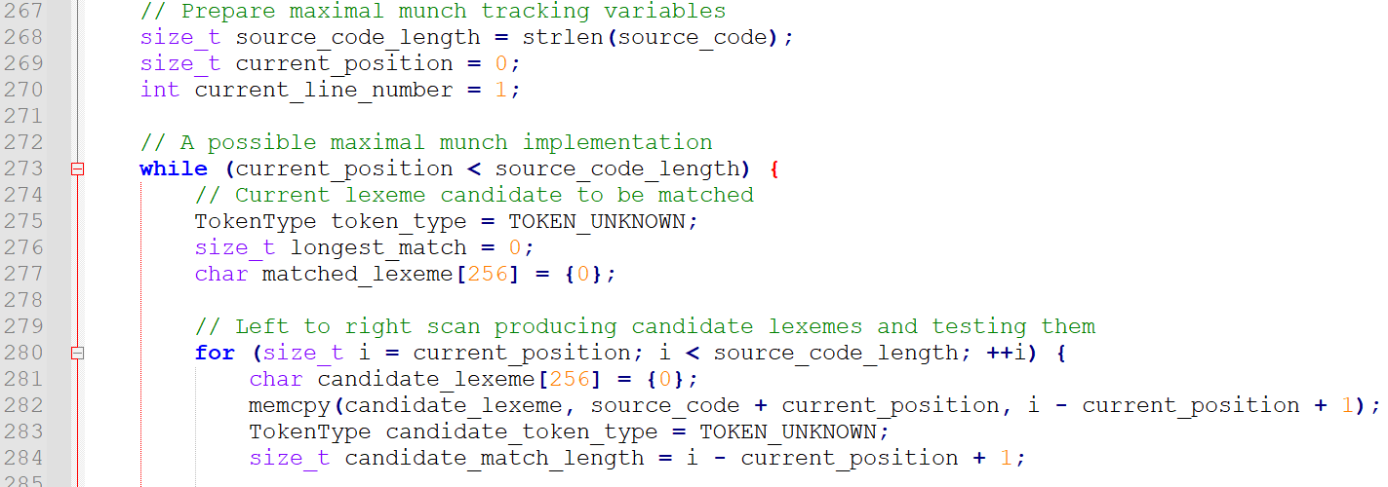
In Code files/1.
Implement a left-to-right scan, character by character, with maximal munch
Step1: Prepare variables for tracking.
Step2: Implement a loop going through characters.

Slide 27
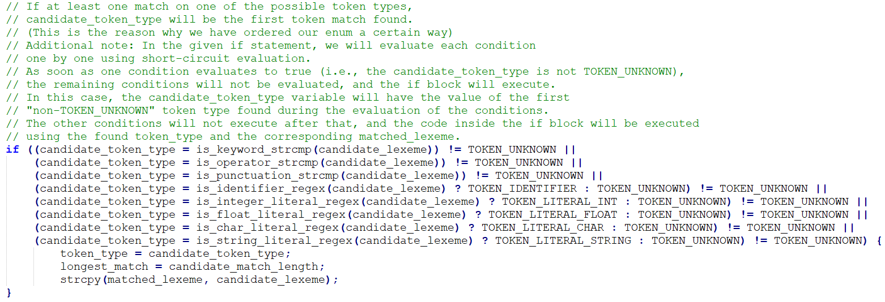
Note: we use the short-circuit evaluation property of the OR statements.
This way, the if() will only compute the first non-unknown token and assign it to candidate_token_type.

Slide 28
(There are obviously other ways to implement this that are a bit more readable, but just a friendly reminder that short-circuiting is a thing!)

Slide 29
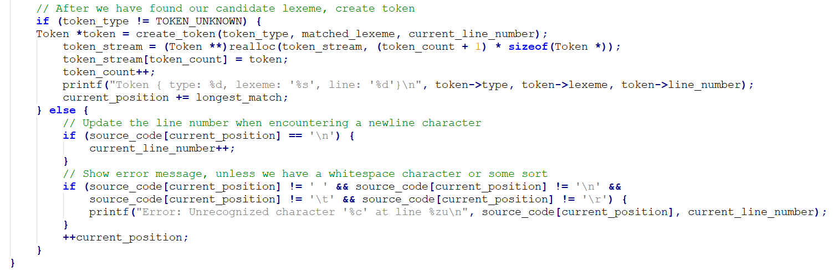
The for loop stops when a lexeme has been found, either
a maximal length one has been recognized,
a problematic one has been recognized,
or a single white space character of some sort has been recognized.
Either way, something is supposed to happen with this lexeme.

Slide 30
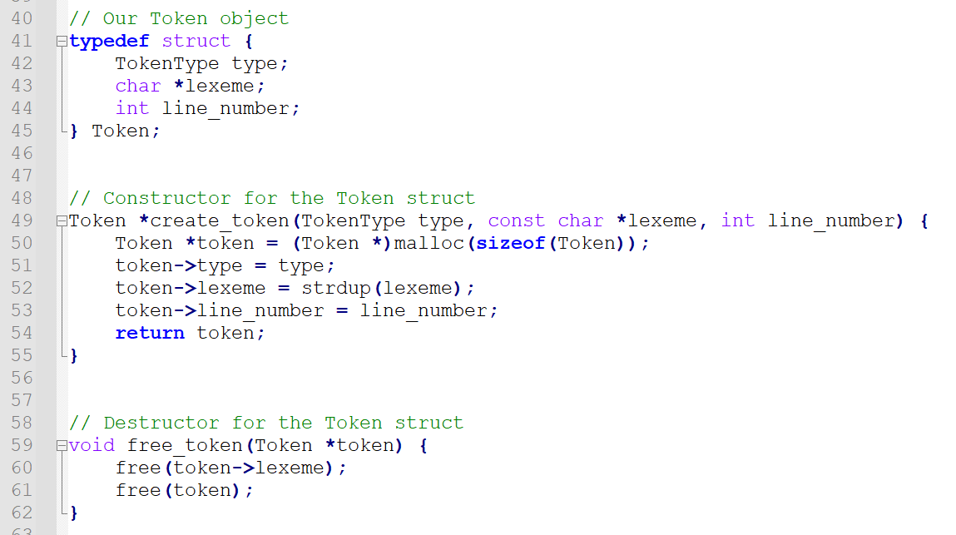
Adjusting our Token object to include a line_number attribute.

Slide 31
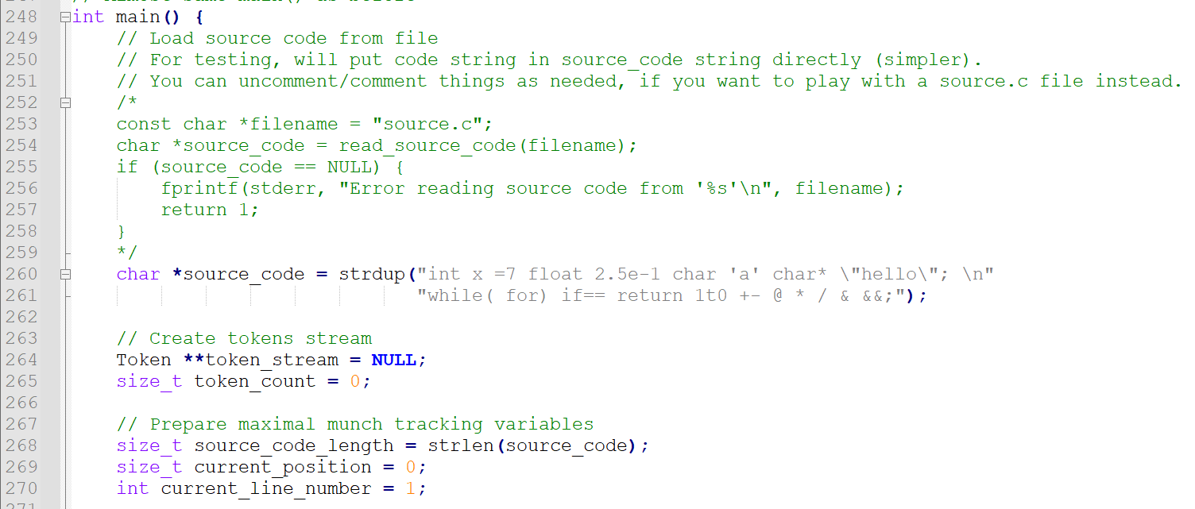
Keep track of the line_number.

Slide 32
In maximal munch procedure, increase line number when \n is encountered

Slide 33
Upon creating a token, use current line number at which token appeared.

Slide 34
Error message shows problematic token along with its line number

Slide 35
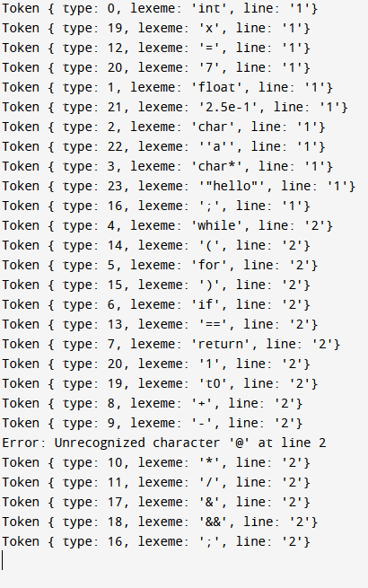
Our Tokenizer v1.3 with some additional features:
Line tracking,
More types of tokens,
Left-to-right scan,
Maximal Munch,
Error messages for unknown tokens!

Slide 36
Limitations to the current code
Our current maximal munch will detect invalid characters, such as @, but will not necessarily detect invalid literals. Instead, it will split them into identifiers and literals.
For instance, it will split the lexeme “1t00” into LITERAL(1) and IDENTIFIER(t00), instead of a single UNKNOWN(1t00).
Per se, it is not that bad, as it will be caught by PARSER on the next step. After all, literals cannot be directly followed by identifiers.
At this point, it is up to us to decide who should raise the error… Should it be the tokenizer or the parser?
We could also implement the Error RegEx mentioned in last lecture and try to catch these faulty literals (e.g. invalid decimal literal).

Slide 37
Recognizing typical errors
We could, however, recognize some typical errors, by using RegEx to flag them. For instance, we could create a token type for invalid decimal literal lexemes.
They start with at least one digit and are then followed by at least one non-digit character.
^[0-9]+[^0-9]+(.)*$
When recognized, interrupt compiler and raise errors, as shown earlier.

Slide 38
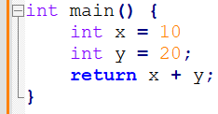
Recognizing typical errors
Idea (code repairing): How about a smart tokenizer that could also recognize that a semicolon is missing at the end of a given statement and add it to the code?
Would it be a good idea or a potential disaster?

Slide 39
Advanced Error Handling in Tokenization
Some advanced tokenizers might in fact attempt to fix these errors!
But they are usually part of a larger system, such as an IDE or a code editor with syntax-checking features.
These advanced tokenizers work in conjunction with other components like parsers and error recovery mechanisms to detect and correct common errors in source code.
When the tokenizer encounters an invalid lexeme, it might try to guess the intended token based on the surrounding context or by applying heuristics.
In difficult cases, it might even flag the error for further processing, leaving it to the parser to figure it out.

Slide 40
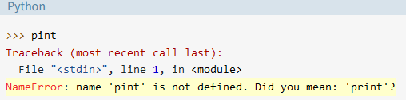
Advanced Error Handling in Tokenization
Some advanced tokenizers might even attempt to fix typical errors!
But they are usually part of a larger system, such as an IDE or a code editor with syntax-checking features.
These advanced tokenizers work in conjunction with other components like parsers and error recovery mechanisms to detect and correct common errors in source code.
When the tokenizer encounters an invalid lexeme, it might try to guess the intended token based on the surrounding context or by applying heuristics.
In difficult cases, it might even flag the error for further processing, leaving it to the parser or user to figure it out.

Slide 41
Recognizing and discarding comments
At the moment, our tokenizer is not correctly recognizing comments.
Comments should be discarded: we shall not bother to create tokens for comments, just discard them during file reading.
To do so, we should recognize when a line comment appears, by recognizing two // in succession.
After that, we should then discard any scanned character until a \n is seen, indicating the end of the comment.
(To some extent, we would do the same thing with block comments using /* and */ as beginning and end of comment symbols Leaving it as extra challenge to students!).

Slide 42
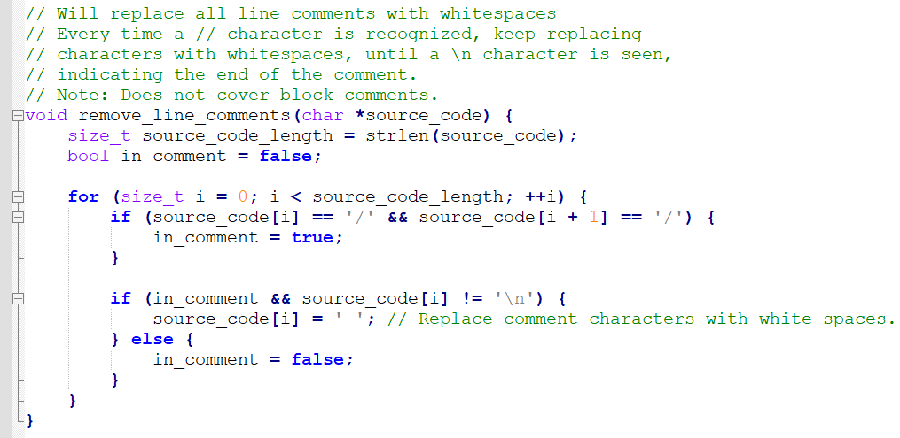
In Code files/2.
We have written a function that will scan the source code and replace comments with white spaces.

Slide 43
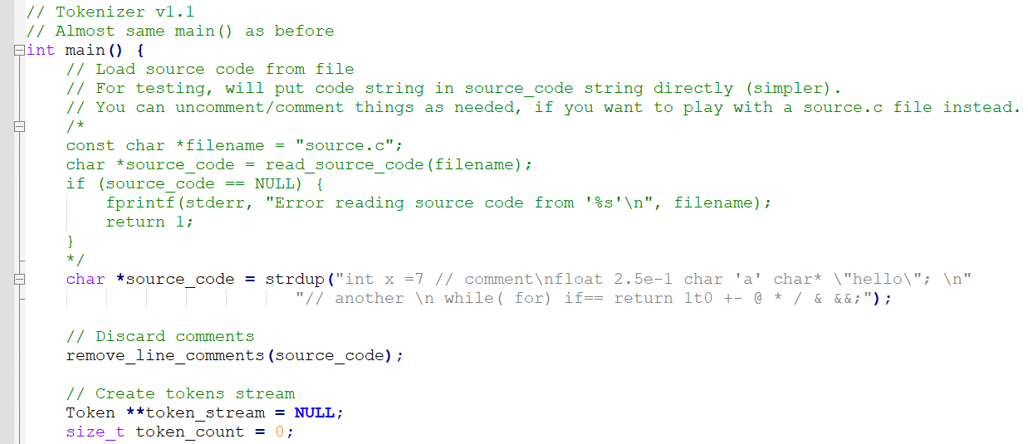
It is then used in our main, after the code has been retrieved from the source file.

Slide 44
Recognizing and discarding comments
Would this work for the code char* s = “Hello // comment in a string;”?
How to amend our function then?
Better to remove comments before or during the maximal much?
At the moment, our tokenizer is not correctly recognizing comments.
Comments should be discarded: we shall not bother to create tokens for comments, just discard them during file reading.
To do so, we should recognize when a line comment appears, by recognizing two // in succession.
After that, we should then discard any scanned character until a \n is seen, indicating the end of the comment.
(To some extent, we would do the same thing with block comments using /* and */ as beginning and end of comment symbols Leaving it as extra challenge to students!).

Slide 45
Pre-processing commands
Pre-processing commands (or pre-processor directives) are instructions for the C pre-processor that are usually evaluated and resolved before the actual compilation process.
During tokenization, we have a few options for handling pre-processor directives:
Simply ignore them: If your goal is to tokenize the C source code without considering the effects of pre-processing directives, you can simply ignore them during tokenization. You can remove pre-processor directives by replacing their characters with spaces, similar to how we handled comments.

Slide 46
Pre-processing commands
Pre-processing commands (or pre-processor directives) are instructions for the C pre-processor that are usually evaluated and resolved before the actual compilation process.
During tokenization, we have a few options for handling pre-processor directives:
Fully process them: If you want to build a complete C compiler, you should pre-process the source code before tokenization. In this case, you would probably implement a separate pre-processor module that handles pre-processor directives as specified by the C standard.
(This is a more complex approach and requires to study what is the C pre-processor doing, which is out-of-scope.)

Slide 47
How about function imports?
For instance, in the case of function imports, what would happen?
The tokenizer's main job is to break the source code into a stream of tokens, which then becomes the equivalent representation of the source code after tokenization.
If you plan on building a more complete compiler or analyser tool, you will need to handle header files and their contents. This requires a file manager, which is out of scope for this course.
In such cases, you should consider implementing a separate pre-processor, which processes the #include directives and other pre-processing commands before tokenization (definitely out-of-scope!)

Slide 48
How about function imports?
To handle imports from other files, the pre-processor will have to:
Detect #include directives in the source code.
Resolve the paths of the included files (either local or from standard libraries in a different folder, probably specified by environment variables such as PATH).
It should raise errors if invalid paths are used or files are not found.
Read the contents of the included files and replace the #include directives with the contents of the included files.

Slide 49
How about function imports?
After the pre-processing of the source code, we will have resolved all #include directives.
The resulting pre-processed source code will have replaced all the include/function imports in the source file with the definition of said functions it has retrieved from additional files.
This new file combining everything is then passed to the tokenizer.
This way, the tokenizer will process the entire code as a single file, and it will generate a token stream for the entire program, as before.
Of course, need to address the issue of multiple functions with identical names included from different files.

Slide 50
So, what happens when #include <stdio.h>?
The C pre-processor searches for the stdio.h header file. The search is usually performed in predefined locations, such as system directories and/or any directories specified by the -I option when compiling.
Once the pre-processor finds the stdio.h file, it reads its contents.
The pre-processor replaces the #include <stdio.h> directive in our source code with the contents of the stdio.h file. This process effectively merges the declarations from the stdio.h header into our source code.
The modified source code (with stdio.h contents) is then passed to the compiler, which compiles the program, starting with tokenization.
The compiler uses the declarations from stdio.h to ensure correct usage of functions and data structures provided by the standard library.

Slide 51
Quiz Time!
What is the significance of left-to-right scanning in the tokenization process?
It allows the compiler to process tokens in reverse order
It enables the compiler to prioritize specific tokens over others
It ensures that the source code is processed in the order it is written
It is a technique to improve the performance of the tokenization process

Slide 52
Quiz Time!
What is the significance of left-to-right scanning in the tokenization process?
It allows the compiler to process tokens in reverse order
It enables the compiler to prioritize specific tokens over others
It ensures that the source code is processed in the order it is written
It is a technique to improve the performance of the tokenization process

Slide 53
Quiz Time!
What does the "maximal munch" principle refer to in tokenization?
The process of consuming the shortest possible sequence of characters to form a token
The process of consuming the longest possible sequence of characters to form a valid token
The process of scanning tokens from right to left
The process of handling comments and pre-processing directives

Slide 54
Quiz Time!
What does the "maximal munch" principle refer to in tokenization?
The process of consuming the shortest possible sequence of characters to form a token
The process of consuming the longest possible sequence of characters to form a valid token
The process of scanning tokens from right to left
The process of handling comments and pre-processing directives

Slide 55
Quiz Time!
In the context of tokenization, how are comments typically handled by a compiler?
By converting comments into tokens for further analysis
By generating a separate file containing all comments
By ignoring and removing comments during the tokenization process
By storing comments in a separate data structure for later use

Slide 56
Quiz Time!
In the context of tokenization, how are comments typically handled by a compiler?
By converting comments into tokens for further analysis
By generating a separate file containing all comments
By ignoring and removing comments during the tokenization process
By storing comments in a separate data structure for later use

Slide 57
Quiz Time!
When handling function imports during tokenization, what is the main responsibility of the compiler?
To optimize the imported functions for better performance
To generate a list of all imported functions and their corresponding memory locations
To identify the imported functions and create tokens for them
To rewrite the imported functions in the native language used to code the compiler

Slide 58
Quiz Time!
When handling function imports during tokenization, what is the main responsibility of the compiler?
To optimize the imported functions for better performance
To generate a list of all imported functions and their corresponding memory locations
To identify the imported functions and create tokens for them
To rewrite the imported functions in the native language used to code the compiler

Slide 59
Practice 1: Removing block comments
Following the logic of the code shown in class, how would you remove block comments from the source code now?
We provide a template in Code files/3.
The function to modify starts on line 110 and is called in the main(), after the line comments have been removed.
(Solution is provided in Code files/4.)
Challenge 1 (after practice 1): Would you raise an error message if a block comment starts /* but does not end, i.e. a */ is not found after a /*? How about a code where a block end */ is found before a block start /*?

Slide 60
Challenge 2: Linking additional files
If the source code in source.c suggests importing a function from a source2.c file, how would you
Read the code in source.c,
Read the code in source2.c,
And eventually replace the include command in the source.c file, with contents from the source2.c file?
Could conflicts happen between functions defined in both files? If so, how would you handle them?
(Good luck coding it, if you feel like!)

Slide 61
Practice 3: A bit of an oopsie
It seems my maximal munch algorithm is missing a break somewhere...
(Oopsie)
Can you find out where?
Or, even better for practice, rewrite your own version of the maximal munch algorithm from scratch?

